Slide 1
NONMEM VI Estimation Method 2 – FOCE
배 균 섭
임상약리학과

Slide 2
Taylor Series Expansion of F (prediction function)
if

Slide 3
FO method
E(Y) ≈ F₀ = PRED
V(Y) ≈ G₀ΩG₀^{T} + diag(H₀ΣH₀^{T})
Y ~ N(E(Y), V(Y))
RV_Normal + RV_Normal = RV_Normal
But, if cannot be assumed?

Slide 4
FOCE without INTER
or
E(Y) ≈ F₁ - G₁*EBE
V(Y) ≈ G₁ΩG₁^{T} + diag(H₀ΣH₀^{T})
Y ~ N(E(Y), V(Y))
-> Use MLE

Slide 5
FOCE with INTER (FOCEI)
Eta-Epsilon interaction consideration means we need second order approximation of objective function (not F) with respect to (w.r.t.). parameters (theta, omega, sigma).
Objective function for FOCEI is basically same with that of LAPLACIAN except the fact that FOCEI uses first derivative of F w.r.t. eta instead of second derivative of F w.r.t. eta.
Objective function for FOCEI will be explained fully after explanation of LAPL method.

Slide 6
INTER option
With INTER option
Without INTER option (default)

Slide 7
INTER option
NONMEM에서 epsilon이 additive error 모형인 경우(Y=F+e)에는 INTER option 사용여부에 상관없이 결과는 동일하다.
Additive 이외 error모형에 대해서는 INTER option을 사용하는 것이 통계학적으로 맞다.
NONMEM FOCE에서 additive error 이외 모형을 사용하면서 INTER option을 넣지 않는 경우 목적함수 계산에는 H0를 사용하지만, table에는 H1을 출력한다.

Slide 8
NONMEM의 목적함수 – FOCE (but not for FOCE with INTER)
All of the above is calculated with eta_true = EBE.

Slide 9
F = PRED or IPRE
PRED: Typical prediction with eta=0 F with eta=0 (F0)
IPRE: Individual prediction with EBE F with eta=EBE (F1)
EBE: MAP, post hoc eta, realized eta
RES = Y – PRED (R0)
IRES = Y – IPRE (R1)
Some my own symbols here
F1, F0, G1, G0, H1, H0, R1, R0 1 means calculated with eta_true = EBE, 0 means calculated with eta_true = 0

Slide 10
POSTHOC option
POSTHOC option is not necessary with FOCE, because EBE (post hoc eta) is calculated at each iteration.
One iteration of FOCE is same with complete run of FO with POSTHOC option.

Slide 11
Demonstration
Compare OFV in two ways
MLE formula using CWRES
Approximation of LAPL objective function (theoretical background will be explained in the next class.)

Slide 12
Example of Control File (THEO data in NONMEM)
$INPUT ID AMT=DROP TIME DV BWT
$DATA THEO
$PRED
DOSE = 320
V = THETA(1) * EXP(ETA(1))
K = THETA(2) * EXP(ETA(2))
KA = THETA(3) * EXP(ETA(3))
F = DOSE/V*KA/(KA-K)*(EXP(-K*TIME)-EXP(-KA*TIME))
Y = F + EPS(1)
$OMEGA BLOCK(3)
Other than additive error model cannot be tested.
Reason: Slide #7
Test also with combined error model

Slide 13
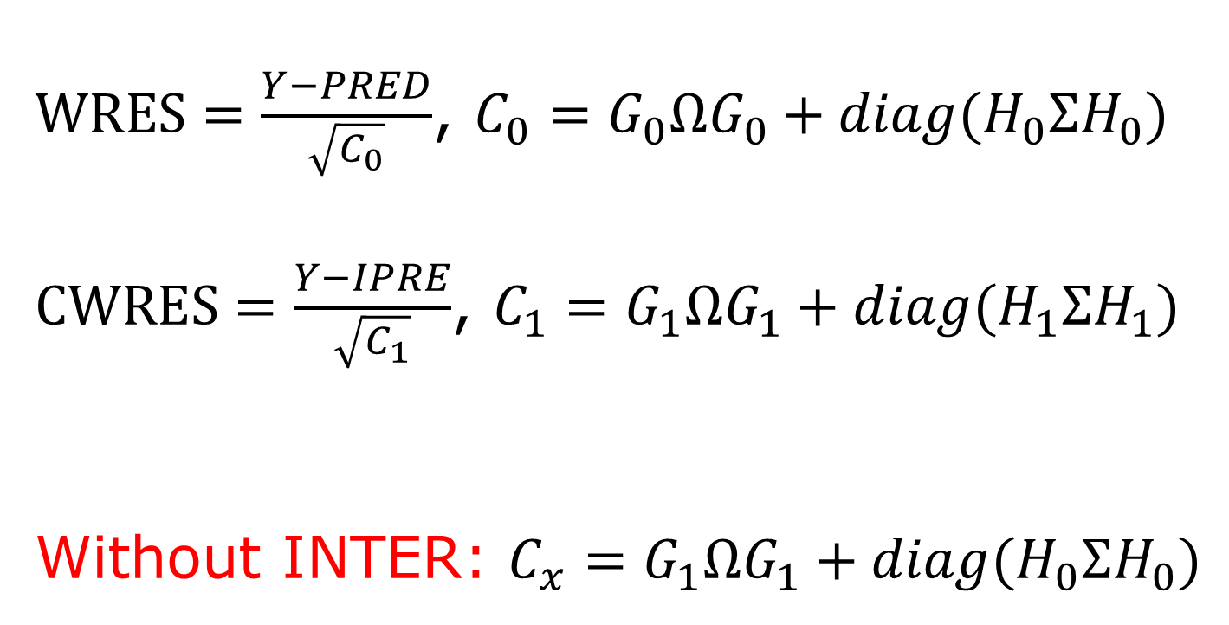
WRES vs CWRES CWRES: Condition WRES
$WRES=\frac{Y−PRED}{\sqrt{C_{0}}}$, $C_{0}=G_{0}ΩG_{0}+diag(H_{0}ΣH_{0})$
$CWRES=\frac{Y−IPRE}{\sqrt{C_{1}}}$, $C_{1}=G_{1}ΩG_{1}+diag(H_{1}ΣH_{1})$
Without INTER: $C_{x}=G_{1}ΩG_{1}+diag(H_{0}ΣH_{0})$

Slide 14
Fragments of R script FO의 확장: WRES -> CWRES
ETAi <- ETA[ETA[,"ID"]==IDs[i],2:(nEta+1)]
DATi <- DataAll[DataAll[,"ID"]==IDs[i],]
Yi <- DATi[,"DV"]
F1i <- DATi[,"IPRE"]
Gi <- DATi[,GNames,drop=F]
Hi <- DATi[,HNames,drop=F]
Ci <- Gi %*% OM %*% t(Gi) + diag(diag(Hi %*% SG %*% t(Hi)))
CWRESi <- SqrtInvCov(Ci) %*% (Yi - F1i + Gi %*% ETAi)
OFVi[i,2] <- log(det(Ci)) + t(CWRESi) %*% CWRESi

Slide 15
Fragments of R script Laplacian의 단순화
COVi <- diag(diag(Hi %*% SG %*% t(Hi)))
invCOVi <- solve(COVi)
Term1 <- log(det(COVi)) + t(Yi-F1i)%*% invCOVi %*%(Yi-F1i)
Term2 <- log(det(OM))
Term3 <- t(ETAi) %*% solve(OM) %*% ETAi
Term4 <- log(det(invOM + t(Gi) %*% invCOVi %*% Gi))
OFVi <- Term1 + Term2 + Term3 + Term4
Laplacian Objective Function 공식과 비교해 볼 것 (3,4항은 의도적으로 순서 바꾸었음)

Slide 16
당부의 말
FO나 Laplacian이 아닌 FOCE with INTER를 주 estimation method로 사용할 것
Additive 이외의 Error 모형에서는 항상 INTERACTION option을 포함시킬 것.
CWRES를 WRES나 IWRES보다 중요시 여길 것

Slide 17
After learning LAPL method
Compare OFVs of
FOCE using MLE
FOCE using approx. of LAPL OF
FOCEI using MLE
FOCEI using approx. of LAPL OF
FOCE vs LAPL without INTER
FOCEI vs LAPL with INTER

